Slide 1

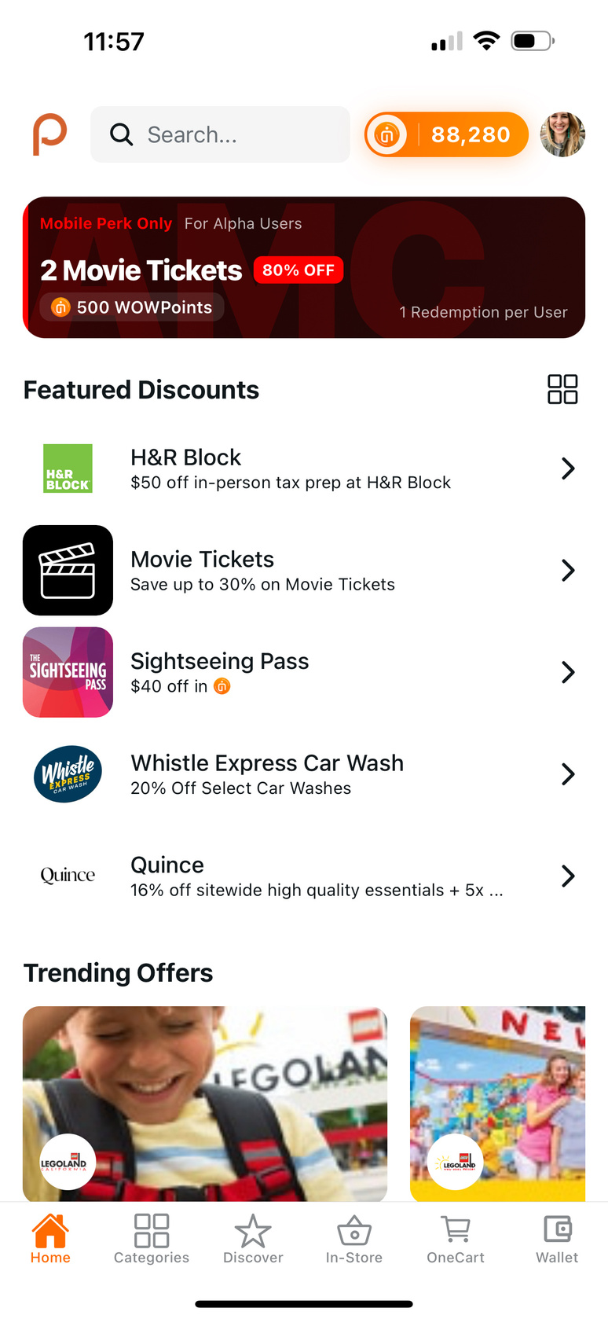
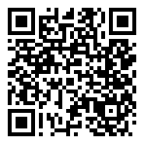
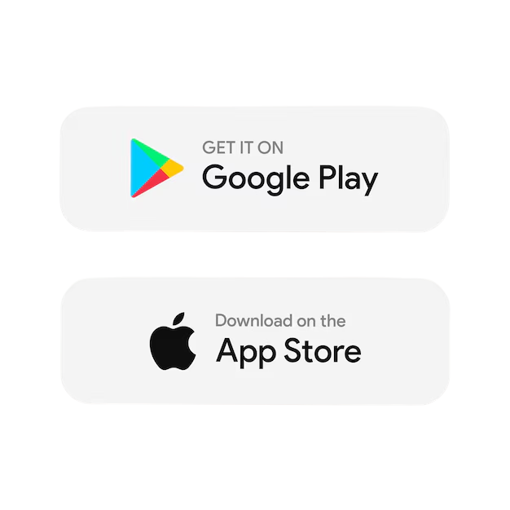
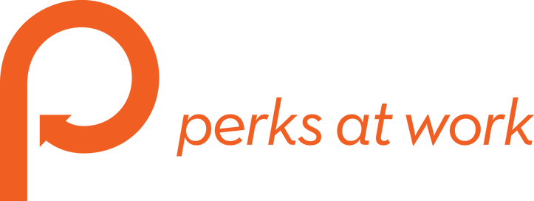
ACCESS OUR EMPLOYEE DISCOUNTS ON THE GO
The Perks at Work Mobile App is now available for employees to download.
Benefits
>
Discover mobile-only discounts and rewards with in-store offers.
>
New ways to spend WOWPoints -- better than cash value!
>
Never miss a discount at the movies! Use your employee discount directly from the app.
>
Stay in the loop with what's trending among your co-workers.
SCAN TO GET STARTED
Visit perksatwork.com to sign up before
downloading the app.

